Slide 1

How to select the right Azure PaaS offering
[speaker]
Notes:
What’s this session about?
There are several overlapping service offerings which could be used for a given software challenge. How do you decide when to use Azure App Service vs. VMs, Cloud Service, Service Fabric, etc.? And App Service itself has several options, so again we have the question of how to decide which one to use for a given software challenge? For example, sometimes developers spin up a Web app with an MVC application to host a single HTTP API, just because that's what they know. If they could use an Azure Function instead, they’d save a lot of money and gain a much simpler management model.
The goal of this session is to overview our PaaS offerings and explain when to use each of them.

Slide 2
The good news: Azure offers dozens of services!

Slide 4
The bad news: You need to know how to pick WHICH of the dozens of services to use…

Slide 5
Even when we narrow it down to application platforms, you’ve got choices… and subchoices…

Slide 6
Which Technology?
Which App Service?
Azure App Service
Function
Cloud Service
Logic app
Service Fabric
API App
Virtual Machine (IaaS)
Mobile App
On Premises
Web app
Notes:
First, which technology do you use? Azure App Service sits higher up on the stack as a PaaS service (more about this on the next slides).
Next, once you’ve decided to use App Service? App Service has several offerings, each of which solves a certain class of problems and offers a unique tradeoff of power, flexibility and economy.
We’ll be digging into that in this session.

Slide 7
In this session, we’ll overview try to help you answer two questions:
When should you use App Service?
When should you use each App Service type?

Slide 8
Balance of responsibility
Responsibility | On-Prem | IaaS | PaaS | SaaS
Applications
Data
Runtime
Middleware
O/S
Virtualization
Servers
Storage
Networking
Balance of control and responsibility depends on the category of the service
MOVE-IN READY
Use immediately with minimal configuration
SOME ASSEMBLY REQUIRED
Existing services are a starting point, with additional configuration for a custom fit
BUILD FROM THE GROUND UP
Building blocks, create your own solution or apps from scratch
Customer
Microsoft

Slide 9
Benefits of Microsoft Azure PaaS Forrester total economic impact results
Interviewed organizations reported on the financial and business benefits of shifting application development and deployment from Azure IaaS to Azure PaaS
466% Return on Investment
$5.91M Net Present Value
80% IT Time Saved
50% Faster Service Deployment Time to Market
Based on five-year, risk-adjusted figures for a composite organization constructed from aggregated interviews with eight Microsoft Azure IaaS customers.
Source: “The Total Economic Impact Of Microsoft Azure PaaS,” a commissioned study conducted by Forrester Consulting, June 2016

Slide 10


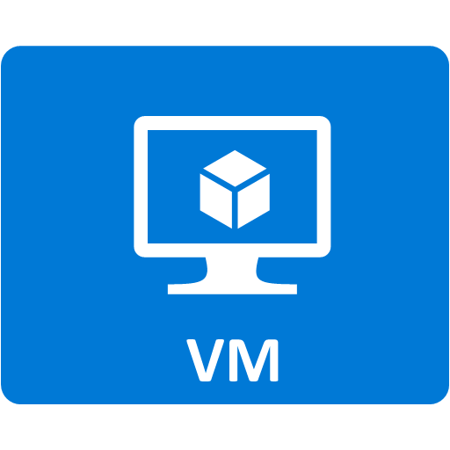


Azure Application Platform
Build on a Developer Platform (PaaS)
App Service
Service Fabric
Functions
Cloud Services
Other PaaS
Web, mobile, API, and logic apps
Massive scale, 24x7 available, multi-component
Serverless, event driven solutions
Custom monolithic 3-tier stateless apps
Cloud Foundry, OpenShift, Apprenda, Jetlastic, etc.
Build on the OS (IaaS)
Web and mobile
Microservices
Serverless Compute
Existing Frameworks
Third-party Frameworks
Virtual Machines and Containers
Storage
Networking

Slide 11
App Service

Slide 12
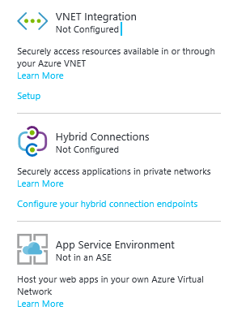
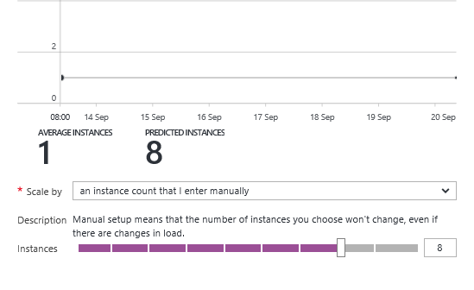
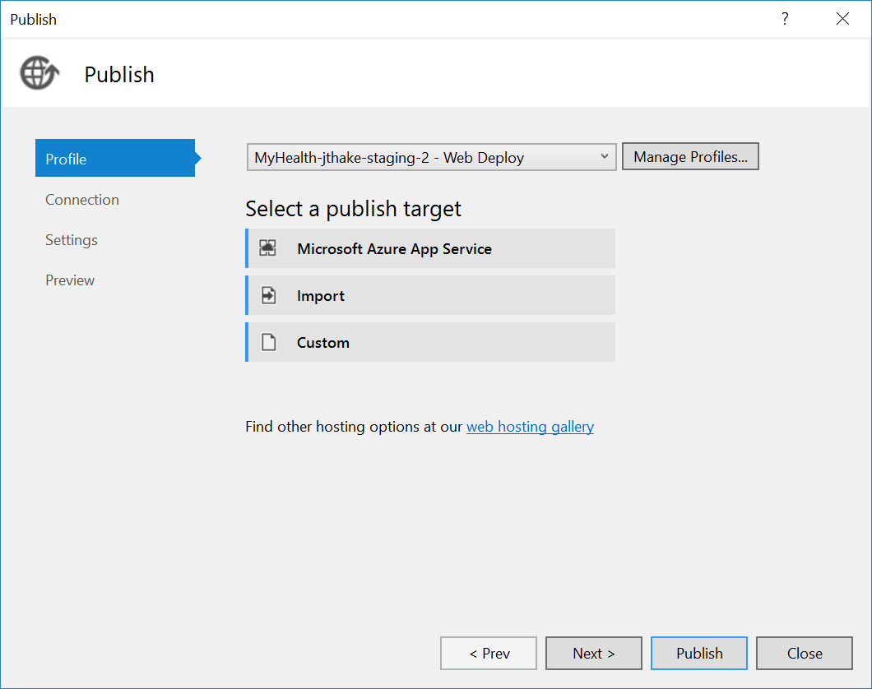
Azure App Service
Enterprise-grade apps
Fully managed platform
High productivity development

Slide 13
Azure App Service
Enterprise-grade apps
Fully managed platform
High productivity development
Global data center footprint
Hybrid support
Built-in auto scale and load balancing
High availability with auto-patching
.NET, Java, PHP, Node, and Python
Staging and deployment
AAD integrated
Secure + compliant
Reduced operations costs
Backup and recovery
Testing in production
App gallery marketplace

Slide 14


Azure App Service Build and scale great web and mobile apps
Web apps
Mobile apps
Logic apps
API apps

Slide 15
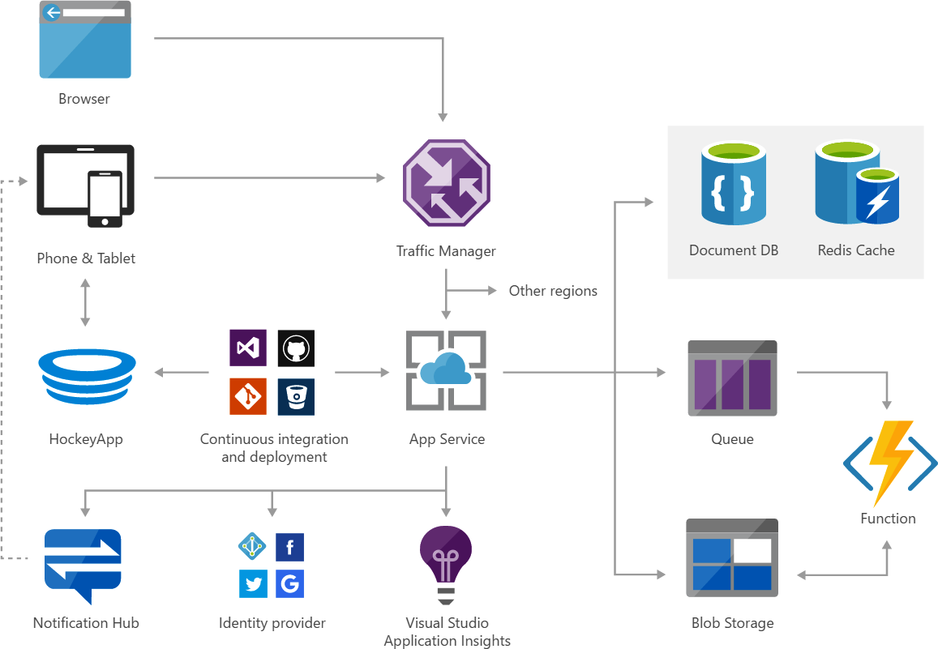
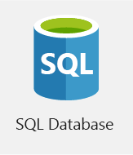
Solution architecture example

Slide 16
Azure Functions

Slide 17

Solution architecture Example: serverless mobile back ends
Photo taken and
WebHook called
Stores in blob storage
Produces scaled images

Slide 18



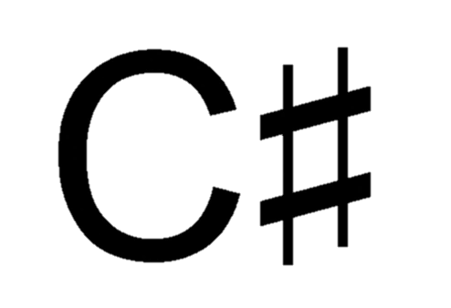

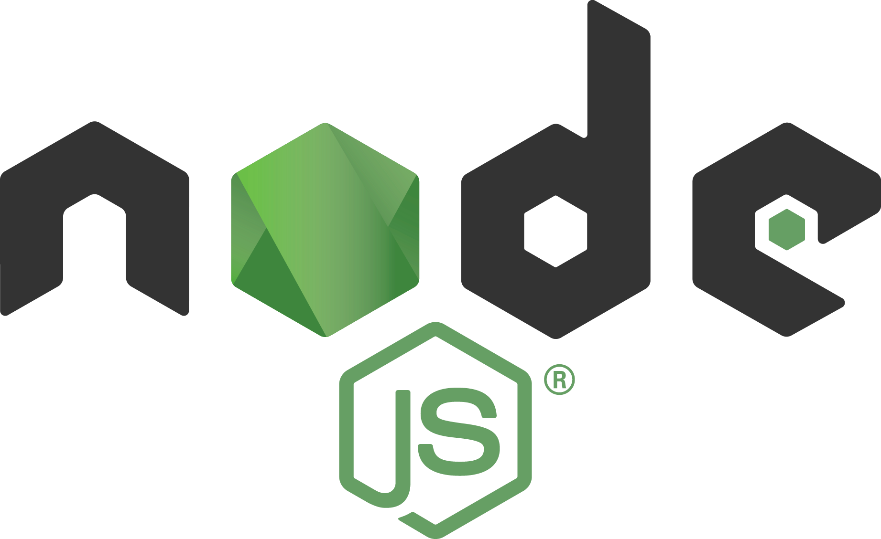







Azure Functions
Serverless
Accelerate development
Bind into services
OneDrive
Box
Twilio
</>
Dropbox
Sendgrid
Azure storage
Event-driven scale
No Ops
Develop your way
Local development
Azure queue storage
Azure event hub
AzureDocDb
Notes:
Azure Functions supports C#, F#, Node.js, Python, PHP, batch, bash, Java
Azure Functions supports the bindings in the WebJobs SDK. Some code samples here: https://github.com/Azure/azure-webjobs-sdk-extensions/tree/master/src/ExtensionsSample/Samples
For example, here’s some code showing the Twilio bindings:
public static void ProcessOrder_Declarative(
[QueueTrigger(@"samples-orders")] Order order,
[TwilioSms(
To = "{CustomerPhoneNumber}",
From = "{StorePhoneNumber}",
Body = "{CustomerName}, we've received your order ({OrderId}) and have begun processing it!")]
out SMSMessage message)
{
// You can set additional message properties here
message = new SMSMessage();
}

Slide 19
Service Fabric

Slide 20
The rise of cloud apps and microservices
Common pain points with Monolithic apps
Large apps are complex
Must redeploy the entire app on each update
Difficult to scale individual pieces
App reliability. Bug in any module can bring down the entire process
Barrier to adopting new technologies
Notes:
See https://channel9.msdn.com/Events/Ignite/2016/BRK2085-TS (1:00:46) for talking points

Slide 21
Modernization with microservices
Monolithic application approach
Microservices application approach
Small, “single role” services
Individually built and deployed. Version and update independently
Integrate using published API calls for overall application’s functionality
Fine-grained, loosely coupled application
App 1
App 1
App 2
1
3
2
4

Slide 22
DIY Microservices
Example: Uber
https://aka.ms/iysml9

Slide 23
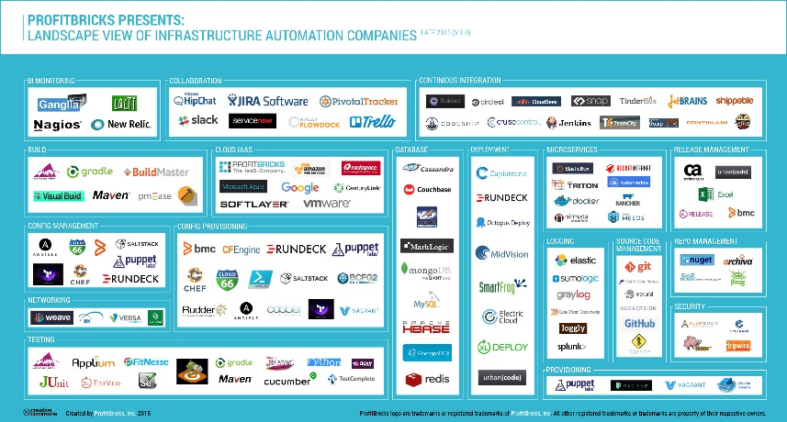
Microservice tools and approaches
Microservices in the wild
Azure Functions
Azure Service Fabric
Implication: Build your own microservices platform
Benefits: Customizable, pick best of breed solutions
Implication: Serverless microservices
Benefits: Quick ramp up, sub second metering, zero ops
Implication: Prescriptive microservices platform
Benefits: Easy to build, deploy and manage microservices at scale
Event-driven scale
No Ops

Slide 24

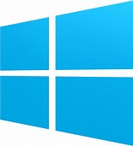

Azure Service Fabric
Lifecycle
Management
Always On Availability
Programming Models
Health & Monitoring
Dev & Ops Tooling
Auto
scaling
Orchestration
Dev Box
Azure
On Premise
Data centers
Other Clouds
Notes:
Microsoft built Service Fabric over the past 10 years and uses it heavily internally (SQL DB, DocDB, Skype for Business, Cortana, InTune)
Service Fabric is a prescriptive, opinionated framework that helps with things like lifecycle management, self-healing, rollback, auto scaling, devops integration
Runs on Windows, Linux, Azure, other clouds

Slide 25
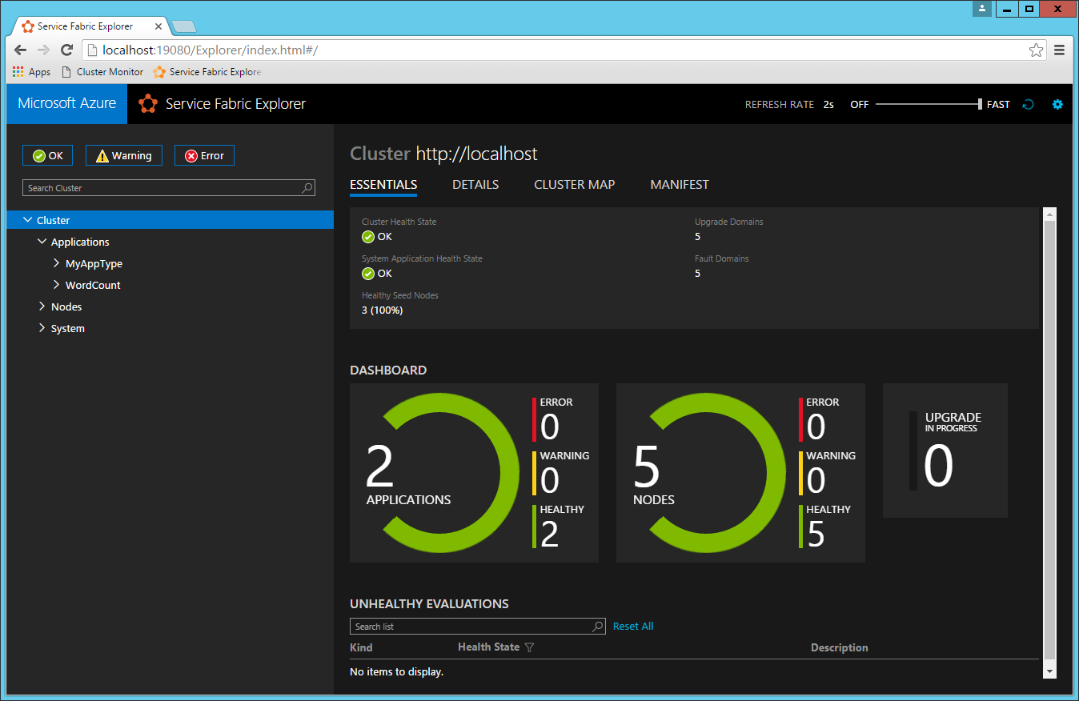
Service Fabric Explorer

Slide 26
Containers

Slide 27
Common pain points
Delivering same functionality to multiple deployment environments
Ensuring consistency and avoiding dependency hell
Unable to migrate and scale apps while maintaining compatibility
Source:
http://www.slideshare.net/dotCloud/why-docker

Slide 28
Why not just Virtualize?
Large size can make it difficult to move images easily across environments
Entire OS needs to be spun up for even writing a simple app
Lack density. Underutilization of host capacity and underlying resources

Slide 29
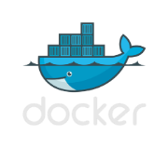



The container revolution
Standard image format for portability across environments
Virtual machine
VM-independence for efficiency, scalability and resilience
Lightweight and agile for Cloud Native apps
Virtual machine
+
Rich ecosystem of images with tools for development and operations
Containers

Slide 30
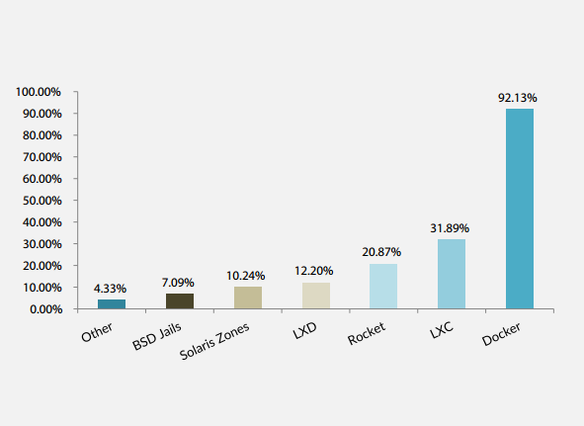
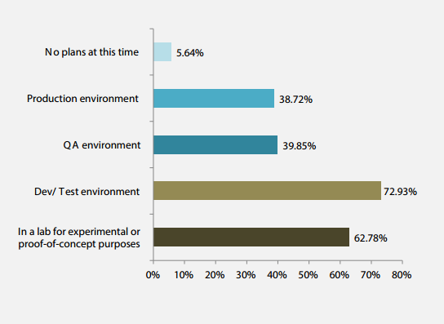
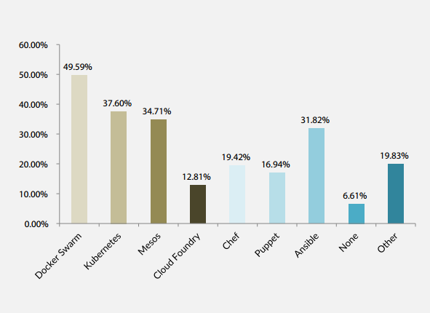
Container adoption trends
Q4 Which container technology have you used or investigated?
Answered: 254 Skipped: 31
Q8 Where are you using container technology? Choose all that apply.
Answered: 266 Skipped 19
Q12 Which container orchestration tools are you considering? (choose all that apply)
Answered: 242 Skipped: 43
* DevOp survey
https://clusterhq.com/assets/pdfs/state-of-container-usage-june-2015.pdf

Slide 31
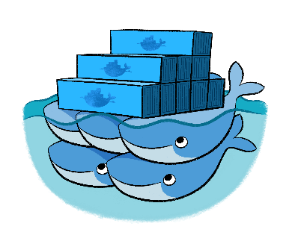

Azure Container Service
Agile, flexible and provides choice
Open source templates for provisioning your environment
Few clicks to a fully optimized enterprise grade container management solution
Mesos
Swarm

Slide 32
App Service on Linux
Familiar App Service Enviroment
PaaS Simplicity
Not an orchestration solution

Slide 33
More info on the services we’ve overviewed:
Azure App Service
Azure Functions
Try: https://functions.azure.com/try
Azure Service Fabric
Try: http://aka.ms/tryservicefabric
Azure Container Service
Try: http://aka.ms/acs
Try: https://tryappservice.azure.com
Download “Understanding Azure - a guide for developers” http://aka.ms/adg
The Total Economic Impact of Microsoft Azure PaaS https://azure.microsoft.com/resources/total-economic-impact-of-microsoft-azure-paas/

Slide 34
So… How do you choose?

Slide 35
Compute: Tradeoffs for control
Compute Option | Audience
App Service | Scalable Web Apps, Mobile Apps, API Apps, and Logic Apps for any device
Cloud Services | Highly available, scalable n-tier cloud apps with more control of the OS
Virtual Machines | Customized Windows and Linux VMs with complete control of the OS
https://azure.microsoft.com/en-us/documentation/articles/cloud-services-choose-me/

Slide 36
App Service
Flexible Easy Cost Efficient Value Add Services
Cloud Service
Install software Remote access
Virtual Machine
Complete Control Persistent Storage
Higher Cost More Management No Value Adds Harder to Scale
Limited Control
More Difficult Fewer Value Adds

Slide 37
Guidance:
Prefer managed services until you NEED more control
Examples: Require custom software install, direct machine access
Observation: When first moving to the cloud, some teams often prefer VM’s for control and comfort. However, this is usually harder and more frustrating than PaaS.

Slide 38
Choosing the right Azure App Service
Web apps
Mobile apps
Logic apps
API apps

Slide 39
Pick the best fit for the problem at hand
Web Apps
Best for web sites
Mobile Apps
For mobile application back ends
Native app features: offline sync, push notifications, client SDK’s
API Apps
RESTful service in the cloud
Simple API access control
Mostly accessed via browser? Good fit.
Integration with Logic Apps
Logic Apps
Automate access and use of data sources with no code
Can integrate with API Apps, Functions, other services
https://azure.microsoft.com/en-us/documentation/articles/app-service-value-prop-what-is/#app-types-in-app-service

Slide 40
Azure Functions vs. Web Jobs
“Azure Functions is all about taking [the] core purpose of the WebJobs SDK, hosting it as a service, and making it easy to get started with other languages. We also introduce the "Serverless" concept here because it made a lot of sense to do so - we know how our SDK scales, so we can do intelligent things for you.”
http://stackoverflow.com/a/36611919

Slide 41
Azure Functions vs. Web Jobs
http://stackoverflow.com/a/36611919

Slide 42
Choosing your Microservices platform
Microservices in the wild
Azure Functions
Azure Service Fabric
Implication: Build your own microservices platform
Benefits: Customizable, pick best of breed solutions
Implication: Serverless microservices
Benefits: Quick ramp up, sub second metering, zero ops
Implication: Prescriptive microservices platform
Benefits: Easy to build, deploy and manage microservices at scale
Event-driven scale
No Ops

Slide 43
Exercises - https://aka.ms/p6hpdx
Exercise 1: Small Business Migration
What service(s) would you recommend?
How would you manage the migration? Would you move one site at a time? How would you handle the data migration?
Exercise 2: IoT Startup
What service(s) would you recommend?
How would you store the sensor data?

